Slide 1
How to calculate $χ_{as}?$

Slide 2
What is $χ_{as}?$
$χ_{as}$ $is number of atoms in the unit cell$
$that do not change$their positions
$$by the operation of a given point group$$
$χ_{as}$ is a positive integer or zero.
$χ_{as}$ depends on rotation.
$χ_{as}$ depends on point group.
$χ_{as}$ depends on the unit cell.

Slide 3
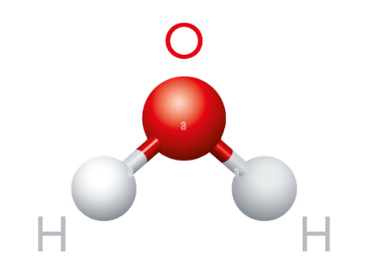
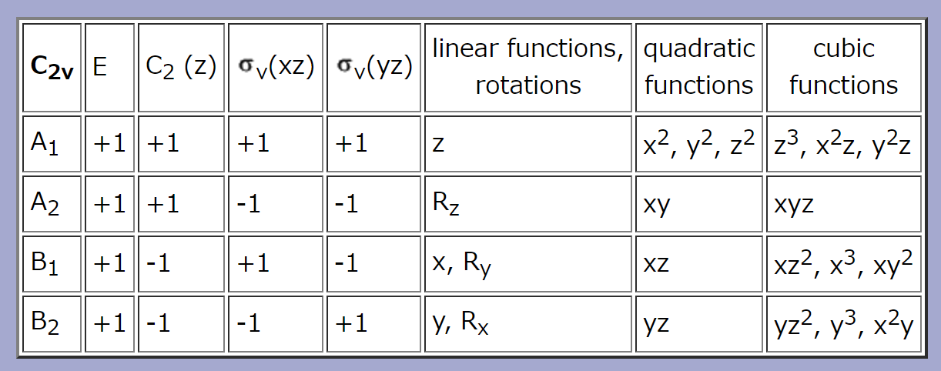
Example 1
Symmetry = $C_{2v}$
Material = H₂O
Rotation = $C_{2}$, $σ_{v}, σ_{v}^{′}$
$χ_{as}\left(C_{2}\right)=$ 1
$χ_{as}\left(σ_{v}\right)=$ 1
$χ_{as}\left(σ_{v}^{′}\right)=$ 3

Slide 4
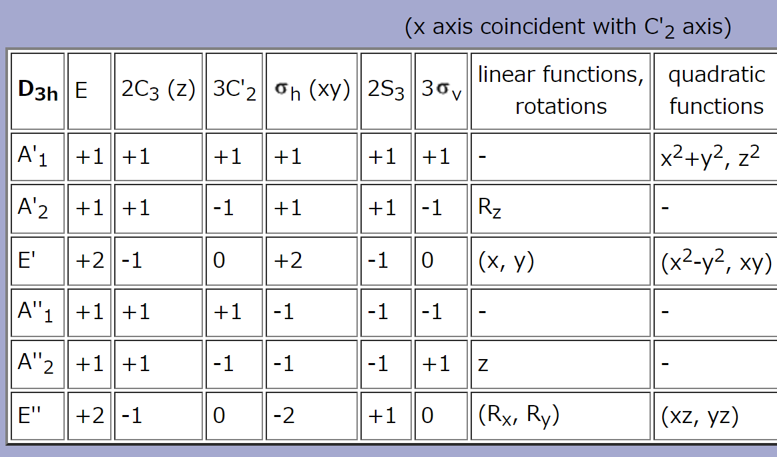
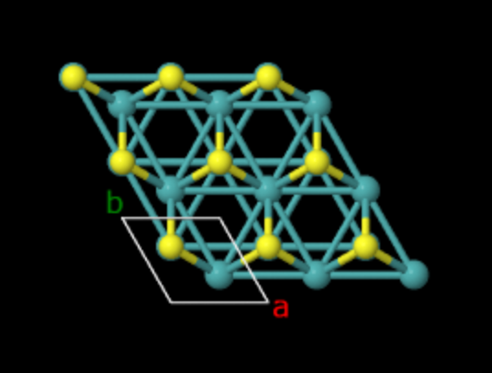
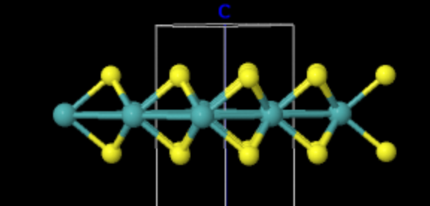
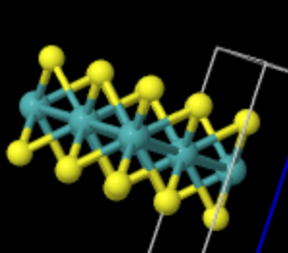
Example 2
Symmetry = $D_{3h}$
Material = MoS₂
Rotation = ${C_{2}, C}_{3}$, $σ_{v}$, $σ_{h}$
S(1)
Mo
S(2)
$$χ_{as}\left(C_{2}\right)=1$$
$$χ_{as}\left(C_{3}\right)=3$$
$$χ_{as}\left(σ_{v}\right)=3$$
$χ_{as}\left(σ_{h}\right)=$ 1

Slide 5
Example 3
Symmetry = $D_{3h}$
Material = MoS₂
Rotation = $C_{3}$, $σ_{v}$, $σ_{h}$
$$χ_{as}\left(C_{2}\right)=1$$
$$χ_{as}\left(C_{3}\right)=3$$
$$χ_{as}\left(σ_{v}\right)=3$$
$χ_{as}\left(σ_{h}\right)=$1
The results do not depend on
selection of the unit cell.

